Slide 1
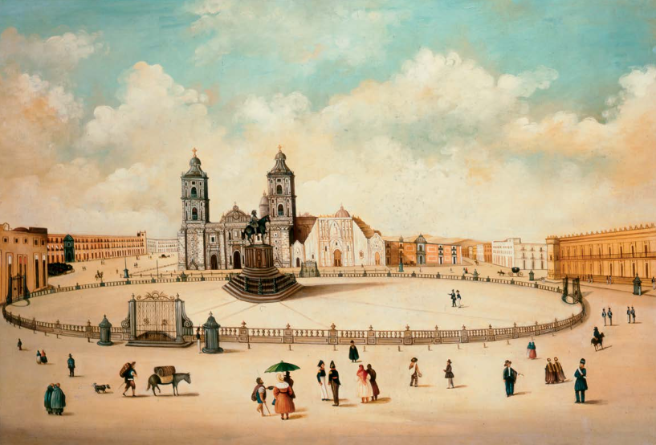
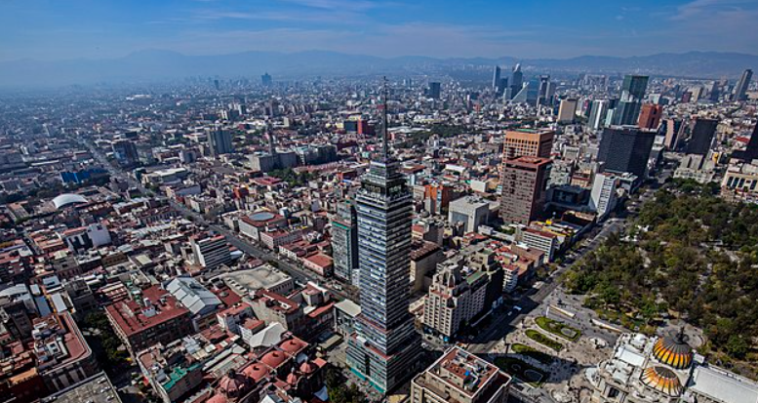
Why travel to Mexico City ?
Mexico City is the capital of the United Mexican States. It was founded on August 13, 1521, by the Spanish in ancient Tenochtitlan and was also the capital of the Viceroyalty of New Spain.

Slide 2
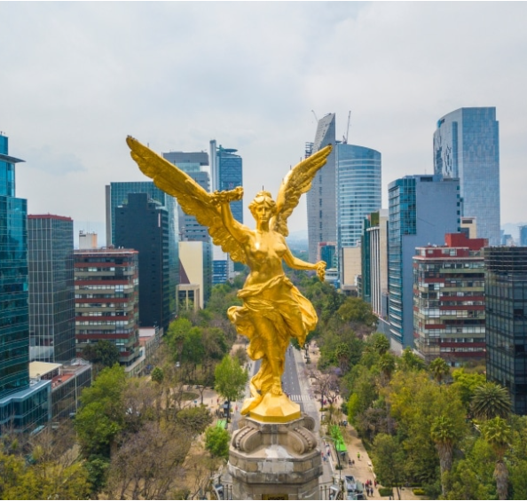
In Mexico City, there are many international IT
companies, including:
IBM, Honeywell, Microsoft, Google, Cisco,
Robert Bosch, Hewlett Packard, Enterprise,
SAP, EPAM Systems, Thomson Reuters.

Slide 3
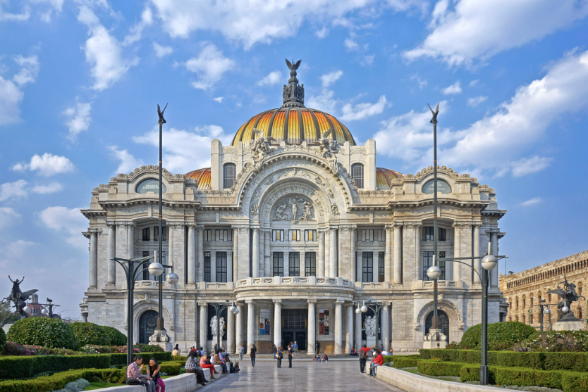
In Mexico City, there is the Palace of Fine Arts, which is
a cultural venue considered one of the most important
in the manifestation of the arts in Mexico. Which has been the scene and witness of impressive artistic, social, and political events.

Slide 4
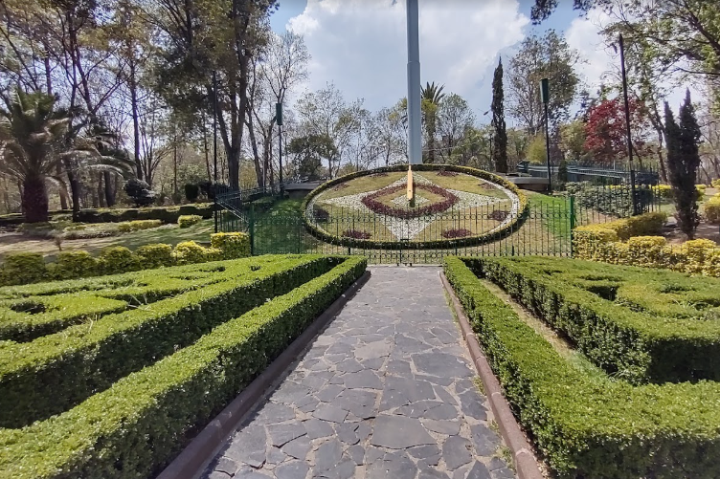
There are many companies for training, such as Netec, which is a company that is at the forefront in IT courses and certifications for companies, so that there is a correct adaptation of these in their processes and ensure that the staff can use them perfectly.

Slide 5
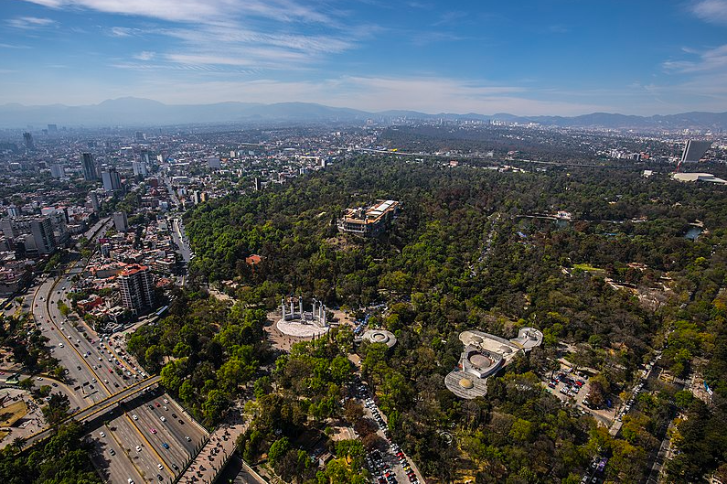
In Mexico City, there is the Chapultepec forest, which is an urban forest that is the largest urban forest in Latin America with 866 hectares and the fourth largest in the world. It is divided into four sections and houses cultural, historical, and tourist sites.

Slide 6
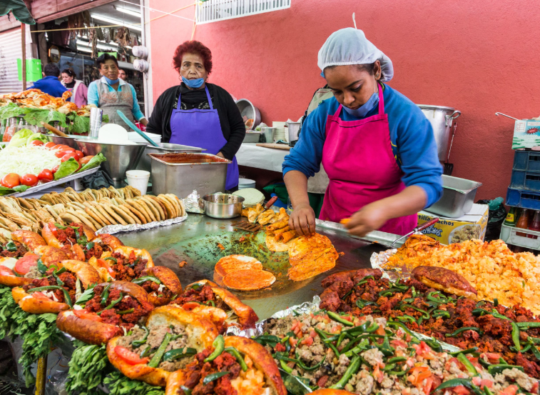
In every corner of CDMX, you can try
alternative street food.

Slide 7

In the city, there are many options for sporting events, such as the Azteca stadium of Club América or the Arena México which is the headquarters of the World Wrestling Council.

Slide 8
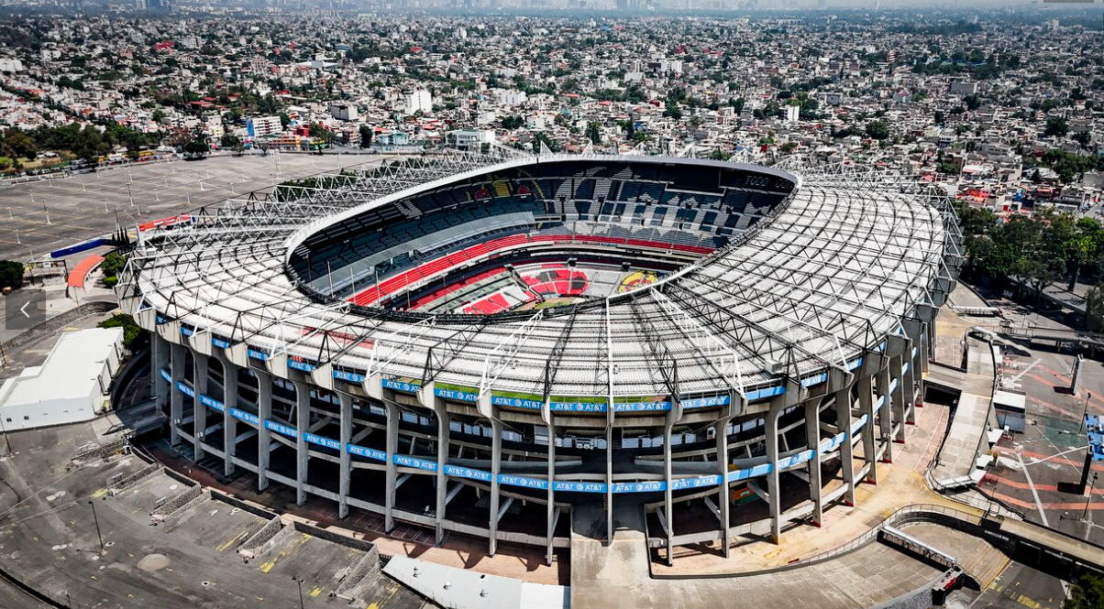
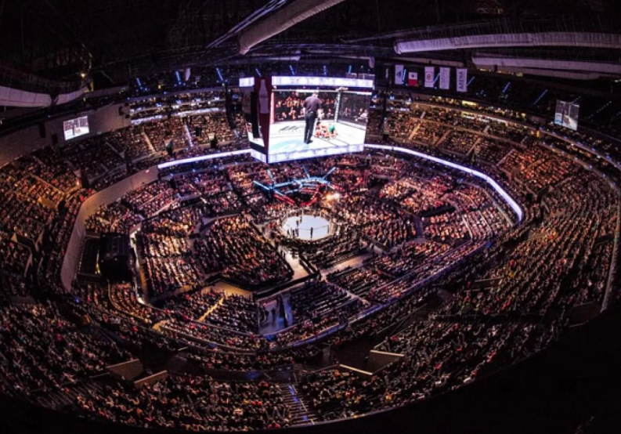
Aztec Stadium
Arena Mexico

Slide 9
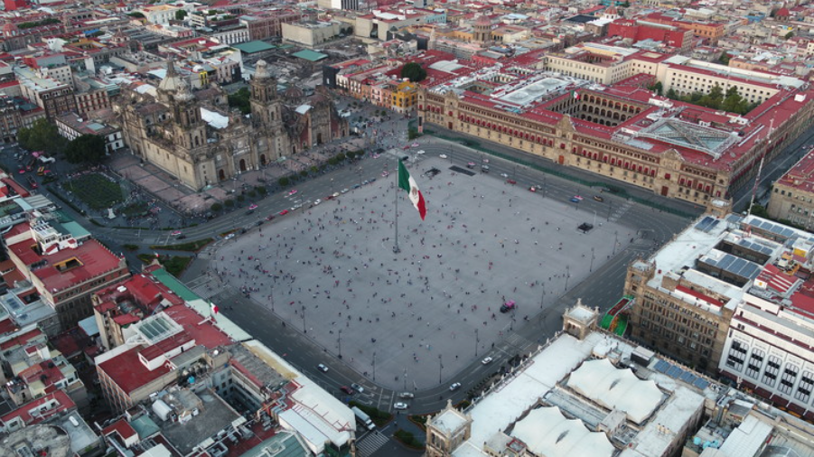
The Plaza de la Constitution, informally known as the Zócalo, is located in the heart of the historic center of Mexico City. Its location was established by the conquistadors to be established just next to what was previously the political and religious center of Mexico-Tenochtitlan, the capital of the Mexica. It is surrounded by the Metropolitan Cathedral of Mexico City to the north, the National Palace to the east, and the northwest by the Temple Mayor Museum.

Slide 10
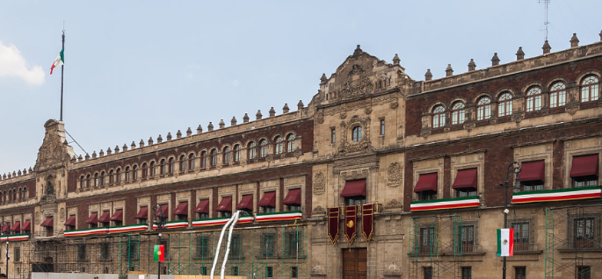
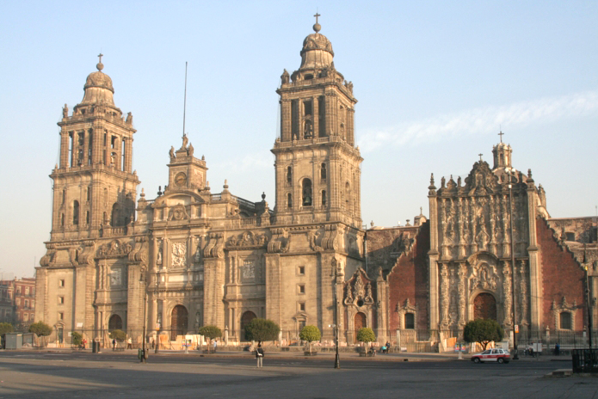
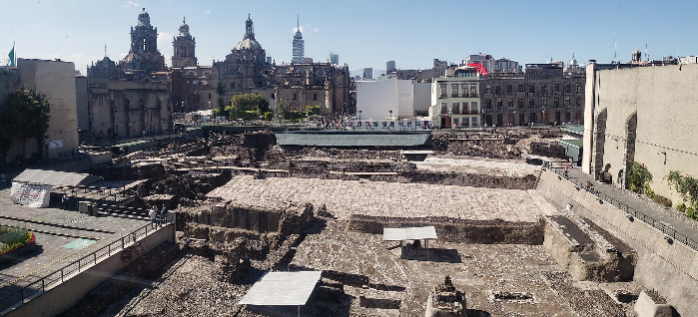
National Palace
Metropolitan Cathedral
Temple Mayor Museum

